Slide 1

INRODUCTION to ML
by
KIET Group of Institutions

Slide 2
Agenda
Why is Artificial Intelligence?
What is Artificial Intelligence?
Applications of Artificial Intelligence?
Subsets of Artificial Intelligence?
What is Machine Learning?
Types of Machine Learning?
Difference between AI, ML, DL

Slide 3

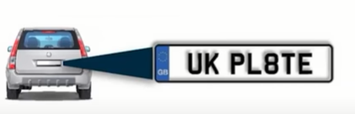
Why Artificial Intelligence?
Let’s understand this with an example:
If a car exceeds the speed limit, you’ll get chalan at your home. How do you think it happens?
For a human to monitor and note down all the numbers is not possible.

Slide 4
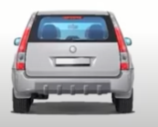
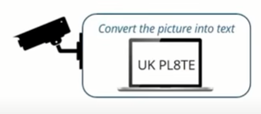
Why Artificial Intelligence?
In order to solve it, we can use a machine to capture the number plate picture and convert it into text format.
With this the risk of human errors have been decreased. At same time machines never get tired. So because of that you are able to capture the picture of all the cars that exceeds the speed limit.

Slide 5


What is Artificial Intelligence?
Artificial Intelligence is the capability of a machine to imitate intelligent human behavior.
AI is accomplished by studying how human behavior thinks and how humans learn, decide and work while trying to solve a problem.
Outcomes of this study used as a basis of developing intelligent software and systems

Slide 6
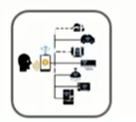


Applications of Artificial Intelligence
speech recognition focuses on the translation of speech from a verbal format to a text
Natural language processing strives to build machines that understand and respond to text or voice data—and respond with text or speech of their own—in much the same way humans do.
Image Recognition is the ability of software to identify objects, places, people, writing and actions in images.
Speech Recognition
Understanding Natural Language
Image Recognition

Slide 7
Subsets of Artificial Intelligence
Artificial Intelligence
Machine Learning is a subset of AI
Machine Learning
Deep Learning
Deep Learning uses neural networks to simulate human like decision making
Deep Learning is a subset of Machine Learning
The concept of artificial intelligence is not new. It was first coined in 1956 but it was just a theoretical concept.
In 2006 the term Deep learning was coined for the first time that overcame the limitations of machine learning
Notes:
Fill the missing gaps?
Task A t_{e} = (10+ (12 x 4) + 16)/ 6 i.e. 12.66 s = (16-10)/6 i.e. 1
Task B t_{e} = (8 + (10 x 4) + 14)/ 6 i.e. 10.33 s = (14-8)/6 i.e. 1
Task C T_{e} = (20 + (24 x 4) + 38)/6 i.e. 25.66 s = (38-20)/6 i.e. 3

Slide 8

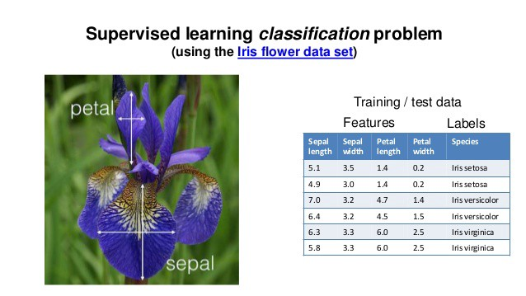
Machine Learning
Machine Learning is a type of Artificial Intelligence (AI) that provides computers with the ability to learn without being explicitl programmed. Let’s understand this with an example.
Problem Statement: Determine the specie of the flower
Learn from the dataset
Predict the specie of the flower

Slide 9
Types of Machine Learning
Supervised Learning
In supervised learning machines are trained using well "labelled" training data, and on basis of that data, machines predict the output.
The labelled data means some input data is already tagged with the correct output.
The aim of a supervised learning algorithm is to find a mapping function to map the input variable(x) with the output variable(y).
In the real-world, supervised learning can be used for Risk Assessment, Image classification, Fraud Detection, spam filtering, etc.

Slide 10
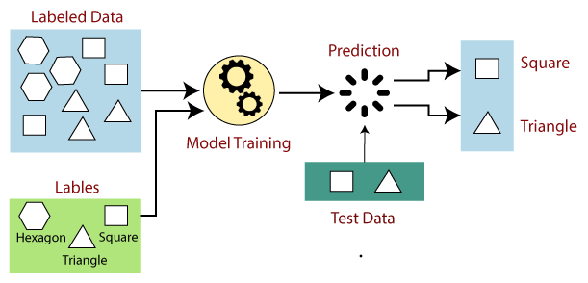
How Supervised Learning works

Slide 11
Types of Machine Learning
Unsupervised Learning
As the name suggests, unsupervised learning is a machine learning technique in which models are not supervised using training dataset.
Instead, models itself find the hidden patterns and insights from the given data. It can be compared to learning which takes place in the human brain while learning new things. It can be defined as:
Unsupervised learning is a type of machine learning in which models are trained using unlabeled dataset and are allowed to act on that data without any supervision.

Slide 12
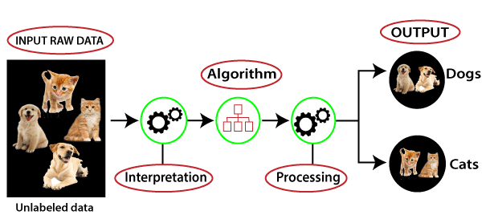
How Unsupervised Learning works

Slide 13
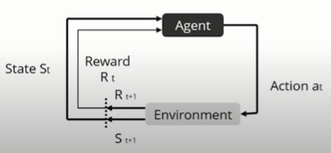
Types of Machine Learning
Reinforcement Learning
Reinforcement learning is learning by interacting with a space or an environment
An RL agent learns from the consequencies of its action, rather than from being taught explicitly. It selects its actions on the basis of its past experiences and also by new choices.

Slide 14
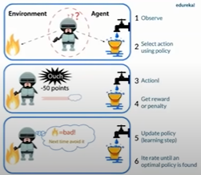
How Reinforcement Learning works

Slide 15
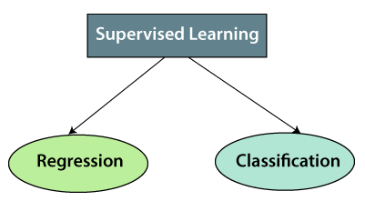
Types of supervised Learning
Regression algorithms are used if there is a relationship between the input variable and the output variable. It is used for the prediction of continuous variables, such as Weather forecasting, Market Trends etc.
Classification algorithms are used when the output variable is categorical, which means there are two classes such as Yes-No, Male-Female, True-false, etc.

Slide 16
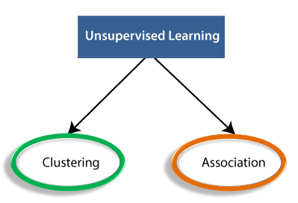
Types of unsupervised Learning
Clustering is a method of grouping the objects into clusters such that objects with most similarities remains into a group and has less or no similarities with the objects of another group.
It is used for finding the relationships between variables in the large database. It determines the set of items that occurs together in the dataset. Association rule makes marketing strategy more effective. Such as people who buy X item (suppose a bread) are also tend to purchase Y (Butter/Jam) item.

Slide 17
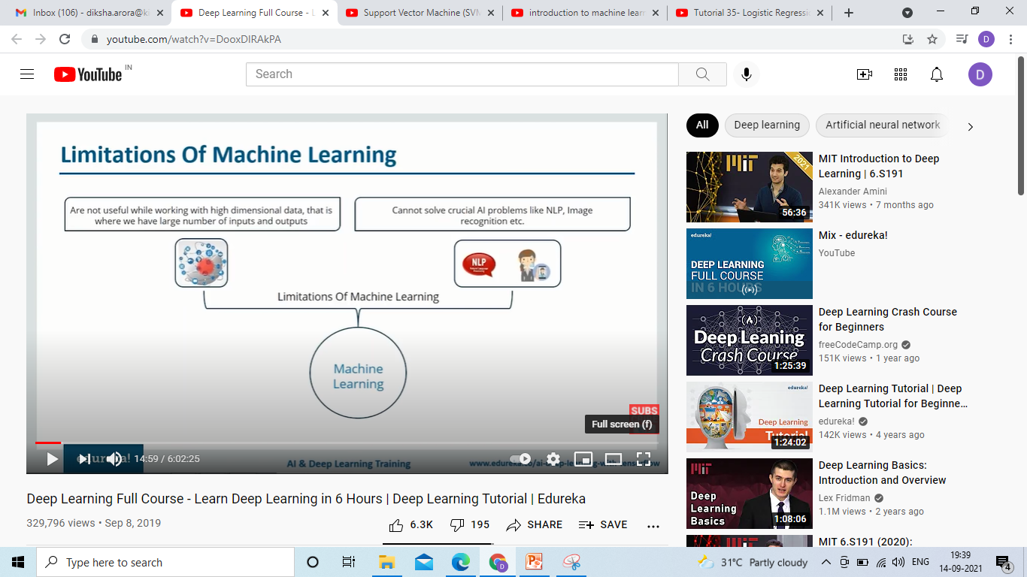
Limitations of Machine Learning
Machine Learning

Slide 18

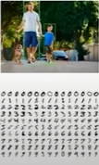
Limitations of Machine Learning
One of the big challenges with traditional Machine Learning models is a process called feature extraction.
For complex problems such as object recognition or handwriting recognition, this is a huge challenge.
Notes:
For eg we want to predict whether there is match today or not. For that we consider some features but forgot to consider some important feature in that case machine learning is not that much efficient that it extract that feature automatically but deep learning is.

Slide 19
Difference between AI, ML, DL
Artificial Intelligence | Machine Learning | Deep Learning
It is basically the study/process which enables machines to mimic human behavior through particular algorithm. | It is the study that uses statistical methods enabling machines to improve with experience. | It is the study that makes use of Neural Networks(similar to neurons present in human brain) to imitate functionality just like a human brain.
AI is the broader family consisting of ML and DL as it’s components. | ML is the subset of AI. | DL is the subset of ML.
AI is a computer algorithm which exhibits intelligence through decision making. | ML is an AI algorithm which allows system to learn from data. | DL is a ML algorithm that uses deep(more than one layer) neural networks to analyze data and provide output accordingly.

Slide 20
Artificial Intelligence | Machine Learning | Deep Learning
The aim is to basically increase chances of success and not accuracy. | The aim is to increase accuracy not caring much about the success ratio. | It attains the highest rank in terms of accuracy when it is trained with large amount of data.
The efficiency Of AI is basically the efficiency provided by ML and DL respectively. | Less efficient than DL as it can’t work for longer dimensions or higher amount of data. | More powerful than ML as it can easily work for larger sets of data.
Examples of AI applications include: Google’s AI-Powered Predictions, Ridesharing Apps Like Uber and Lyft etc. | Examples of ML applications include: Virtual Personal Assistants: Siri, Alexa, Google, etc | Examples of DL applications include: Image analysis and caption generation, etc.

Slide 21
References
https://youtu.be/DooxDIRAkPA
https://www.geeksforgeeks.org/difference-between-artificial-intelligence-vs-machine-learning-vs-deep-learning/

Slide 22
THANK YOU

